Slide 2
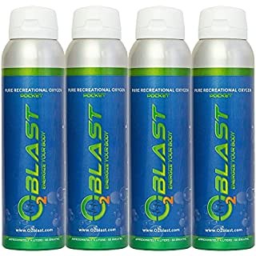
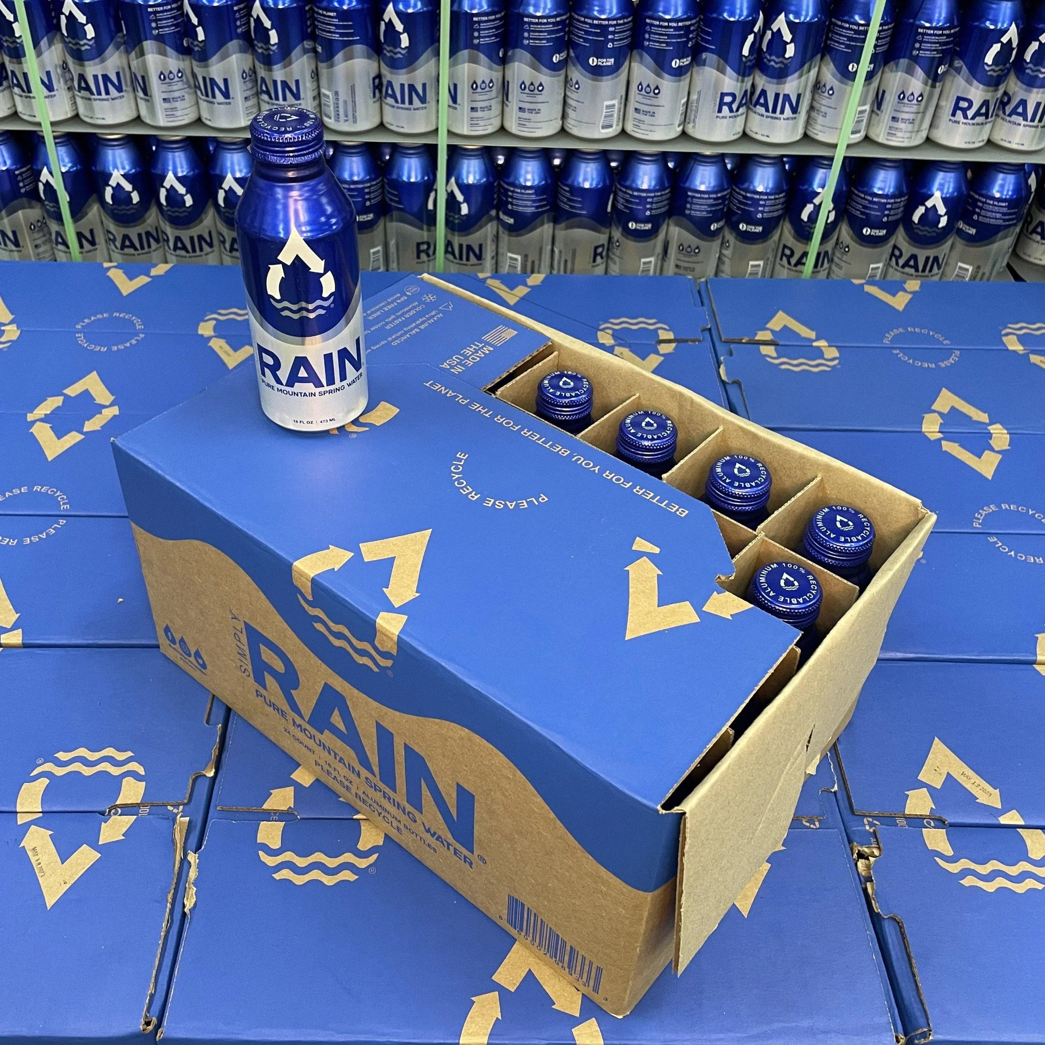
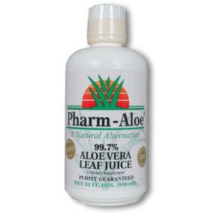

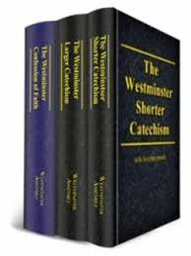


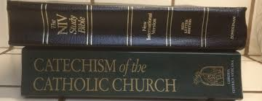



99.7% Pure Oxygen
ENERGIZE YOUR BODY -
99.7% Aloe Vera Juice 32oz
Pure Mountain Spring Water
Air Purifier
24 oz Water Purifier Bottle

Slide 3
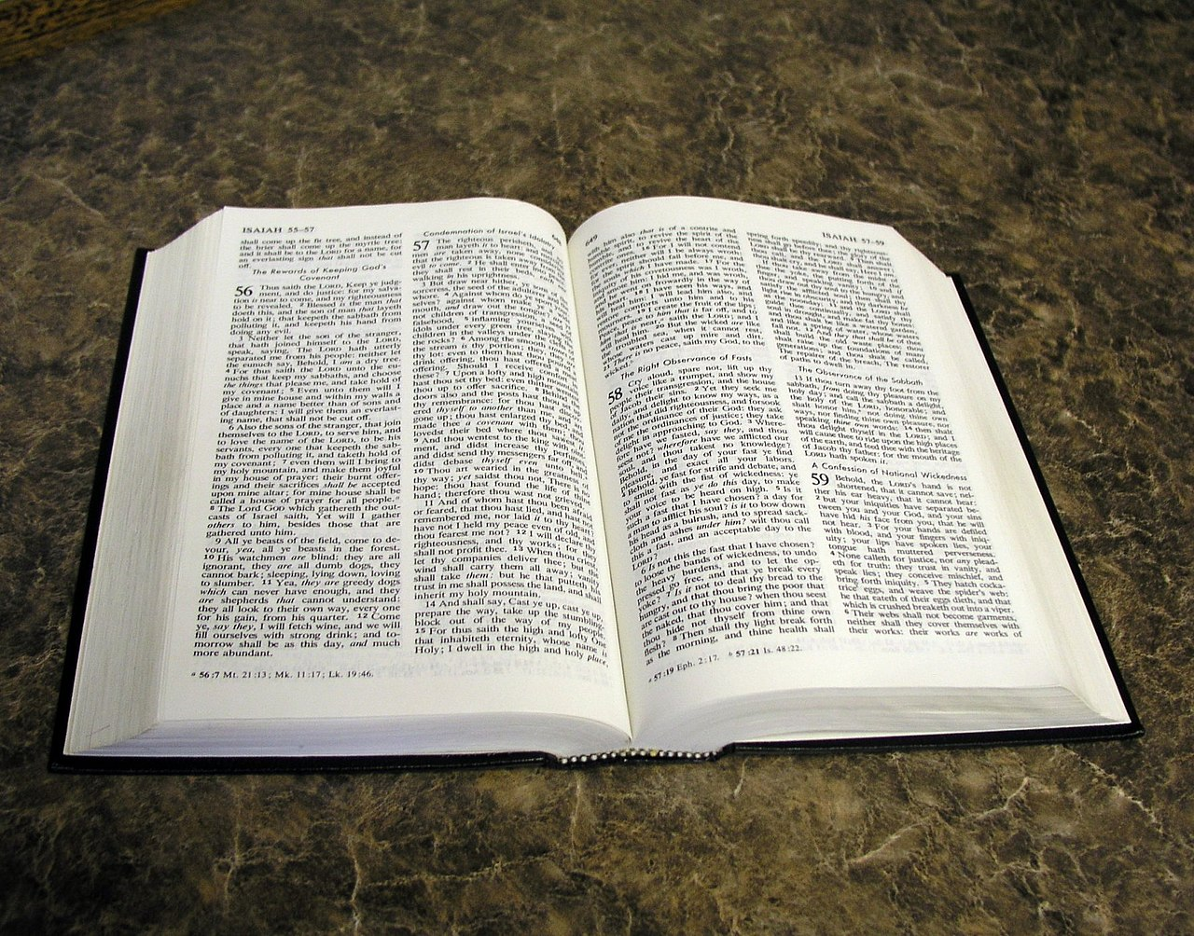
PURE GOSPEL OF CHRIST

Slide 4

“Watered Down Version”
“God’s Law Is Too Strong” (Harsh) – John 6:60,61,66-69 “From that time many of His disciples went back and walked with Him no more…Lord, to who shall we go? You have the words of eternal life…”

Slide 5
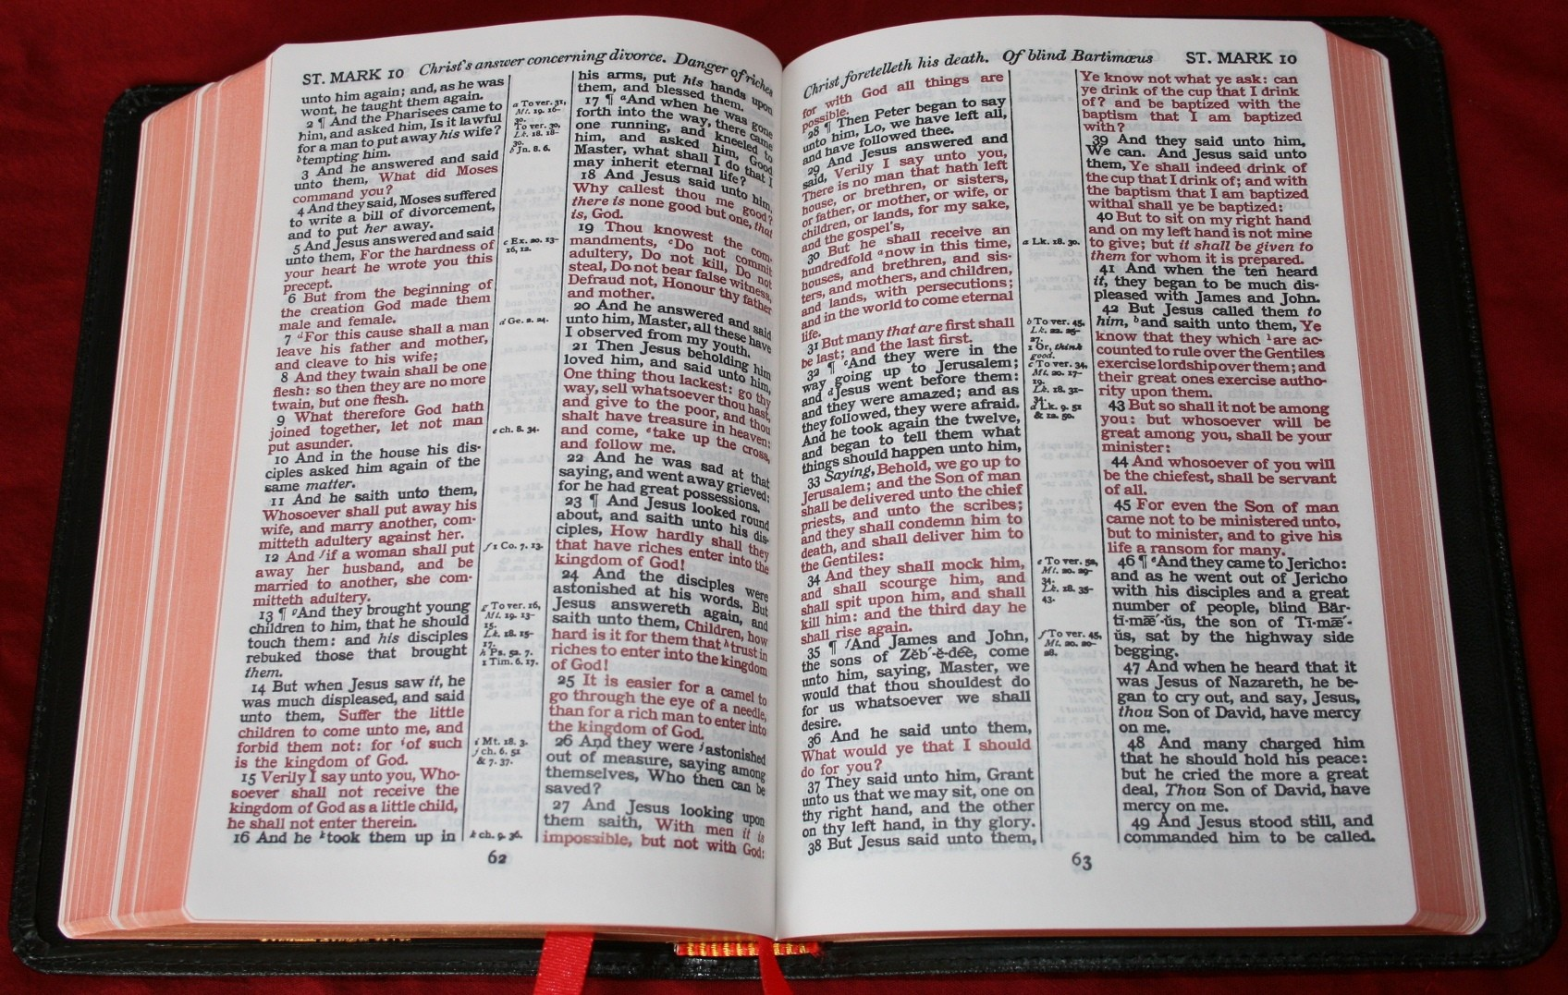
“The Lord expects too much!”
“Just go by the RED PRINT…”
“Only the golden rule…”
“Nothing about Marriage, Riches, Hypocrites, etc.”
Acts 7:51-58 “You always resist the Holy Spirit”
“Your word is very pure; Therefore Your servant loves it.” Psalm 119:140

Slide 6
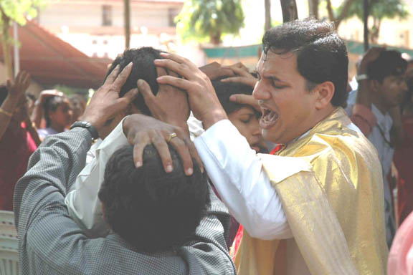
The Spiced Up Version
Emotionalism – stir human emotions to overcome reason
1 Corinthians 13:8-12
Ephesians 3:3-6 “when you read, you may understand my knowledge in the mystery of Christ”

Slide 7

“Decently and in order..”
1 Corinthians 14:40
1 Chronicles 16:36 “and the people said ‘Amen!’ and praised the Lord.”
Nehemiah 5:13; 8:6 “All the people answered, ‘Amen, Amen!’”
Momentary excitement avails nothing – Luke 9:23; Acts 2:46,47; 17:11

Slide 8
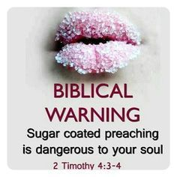
Sweetened Version
“Teach I hear only that God is love” – John 3:16
John 3:3-5 “born of water and the Spirit..”
James 2:24,26 “not by faith only…”
Proverbs 30:12 “not washed from its filthiness”
Matthew 7:21-23 – Not all who THINK they are saved, ARE!

Slide 9

Preserved In The Past
“Times have changed!” “We must adjust to accommodate the culture.”
God does not change – Malachi 3:6; Psalm 102:26-28
Hebrews 1:10-12 Applied to Christ
James 1:17 “no variation of shadow or turning.”

Slide 10
Preserved In The Past
Acts 2:39 “as many as the Lord our God will call.”
2 Thessalonians 2:14 “He called you by our gospel..”
People was NEW doctrines!
They want to MINIMIZE SIN – Take AUTHORITY from Christ- Salve hearts broken by sin- Blend with CULTURE instead of being DISTINCT!

Slide 11
Preserved In The Past
2 Corinthians 6:14-18 “Do not be unequally yoked together with unbelievers… what fellowship has righteousness with lawlessness?”
Romans 12:1,2 “do not be conformed to this world, but be transformed”

Slide 12
“Must Have Fresh Produce”
1 Peter 1:22 “you have purified your souls in obeying the truth”
1 Peter 2:2 “as newborn babes, desire the pure milk
of the word, that you may grow thereby.”
1 John 3:3 “purifies himself, just as He is pure.”

Slide 13

Some Not Seeking Purity
Titus 1:15 “those who are defiled and unbelieving nothing is pure”
Work & Worship of church – John 4:24
N.T. produces Unity, Love & Fellowship – Not Division & Denominationalism- 1 Timothy 1:5
2 Timothy 2:20-22; James 3:13-18

Slide 14

How Do You Become Pure In Heart?
Matthew 5:8 “Blessed are the pure in heart..”
Obey the Gospel : 1 Peter 1:22
Faith - 1 Timothy 1:5; Hebrews 11:6
PURE
Repentance – 2 Corinthians 7:10
Confession – Acts 8:37
Baptism – 1 Peter 3:21
Heaven – Revelation 21:18, 21-27

